Slide 1
Membership & Roles

Slide 2
Membership Services
Adds programmatic support for authenticating, adding, creating, deleting, and modifying user account information, along with Web controls for helping with accomplishing these tasks.

Slide 3
Membership Overview
ASP.NET’s membership feature is an API that provides methods for accomplishing common user account-related tasks.
  Creating accounts
  Deleting accounts
  Authenticating a user’s supplied credentials
  Etc.

Slide 4
Membership Overview
The Membership API is exposed to ASP.NET Web pages and server controls via the Membership class.
ASP.NET ships with two membership providers:
  SqlMembershipProvider –account information accessed/stored in a SQL Server database
  ActiveDirectoryMembershipProvider – account information accessed/stored from Active Directory.

Slide 5
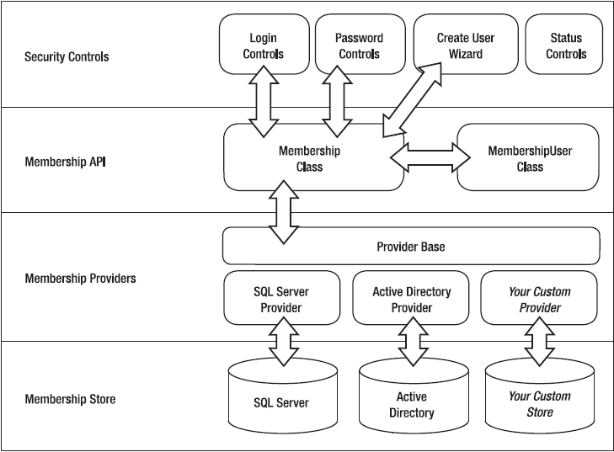
Architecture of the membership API

Slide 6
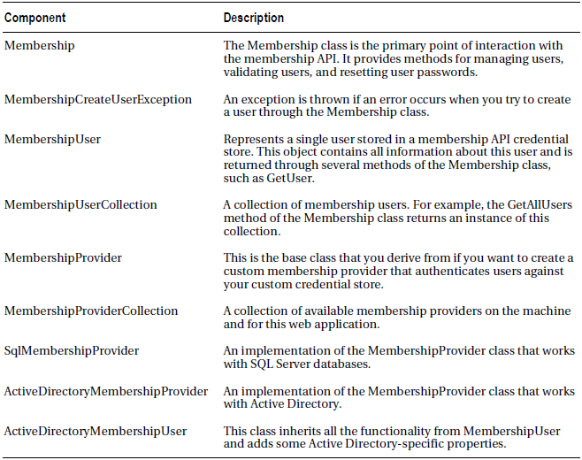
The Membership API-Related Classes of the System.Web.Security Namespace

Slide 7
Configuring the Website
In order to use the Membership functionality we need to:
  Tell ASP.NET what membership provider we want to use.
  Create the infrastructure necessary to support the provider selected.
  Configure forms-based authentication and define the authentication rules.
The default Membership provider used is SqlMembershipProvider (named AspNetSqlProvider)

Slide 8
Configuring the Website
The website can be configured in one of two ways:
  From the ASP.NET Website Administration Tool (AWAT)
  Through markup in Web.config

Slide 9
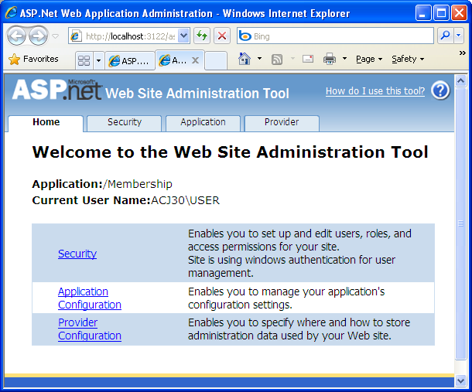
Configuring the Website
Option 1: Use the ASP.NET Web Site Administration Tool
  To launch this, go to the Website menu and choose the ASP.NET Configuration option.

Slide 10
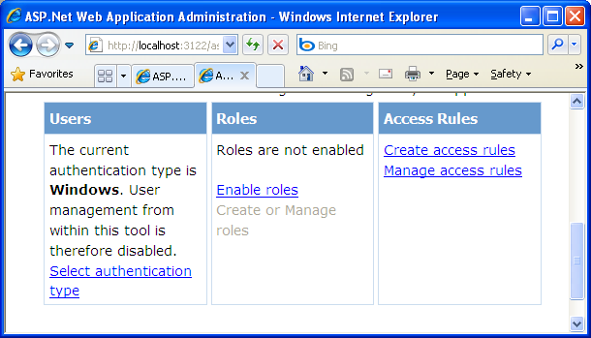
Configuring the Website
From the Security tab you can configure authentication, roles, and authorization settings.

Slide 11
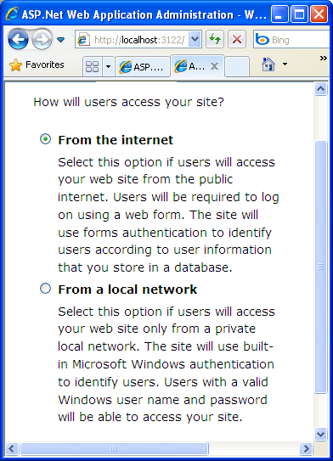
To use forms-based authentication and to automatically create the infrastructure needed for the SqlMembershipProvider, click on Select Authentication Type and choose the “From the Internet” radio button.

Slide 12
Configuring the Website
Choosing “From the Internet” will:
  Configure your site to use forms-based authentication (Web.config):
  Will create the ASPNETDB database in your App_Data folder, which has the tables necessary for user accounts.
<configuration xmlns="...">
<system.web>
<authentication mode="Forms" />
</system.web>
</configuration>

Slide 13
Configuring the Website
The ASPNETDB database stores user account information in the following two tables:
  aspnet_Users:
    UserId – uniquely identifies each user
    UserName – the user’s username
  aspnet_Membership:
    UserId
    Password
    Email
    Security Question / Answer
    IsLockedOut
    LastLoginDate, Etc.
There is a one-to-one correspondence between the two tables. That is, for each record in aspnet_Users, there is a matching record in aspnet_Membership.

Slide 14
apsnet_regsql.exe
To create database tables and stored procedures in a database of your choice such as MyDatabase
  aspnet_regsql -S (local)\SQLEXPRESS -E -A all -d MyDatabase

Slide 15
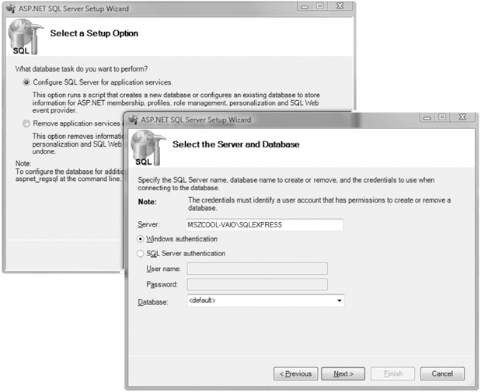
The apsnet_regsql.exe wizard user interface

Slide 16
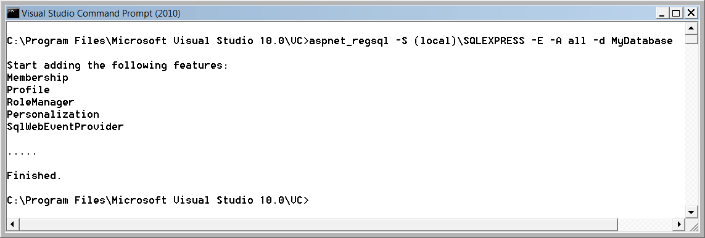
Executing aspnet_regsql.exe for installing the database

Slide 17
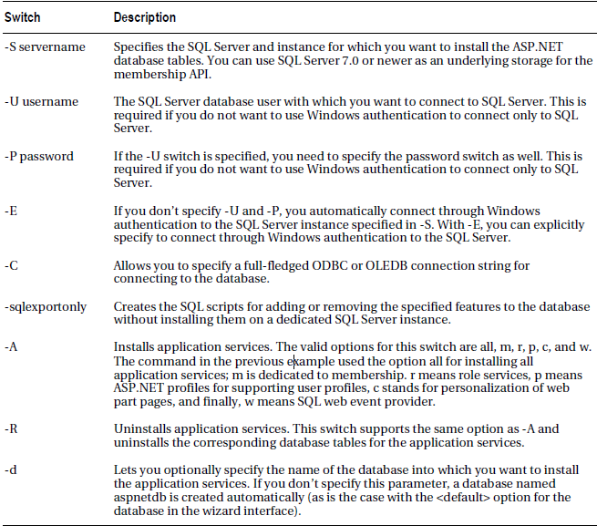
Command-Line Switches of aspnet_regsql.exe

Slide 18
Configuring Connection String and Membership Provider
Need to configure the connection string and membership provider to use your own SQL Server database, or even your custom membership provider and store

Slide 19
Configuring Connection String
<connectionStrings /> section is located directly below the <configuration /> element
<connectionStrings>
<add name="MyMembershipConnString"
connectionString="data source=(local)\SQLEXPRESS;
Integrated Security=SSPI;
initial catalog=MyDatabase" />
</connectionStrings>

Slide 20
Configure the membership provider for the application
Add a <membership> element to your Web.config.
In this element, add a new provider setting using the SqlMembershipProvider, but with custom values

Slide 21
Configure the membership provider for the application
And customize the membership’s settings, as needed…
<system.web>
<authentication mode="Forms" />
<membership defaultProvider="MyMembershipProvider">
<providers>
<add name="MyMembershipProvider"
connectionStringName="MyMembershipConnString"
applicationName="MyMembership"
enablePasswordRetrieval="false"
enablePasswordReset="true"
requiresQuestionAndAnswer="true"
requiresUniqueEmail="true"
passwordFormat="Hashed"
type="System.Web.Security.SqlMembershipProvider" />
</providers>
</membership>
Use the SqlMembershipProvider…

Slide 22
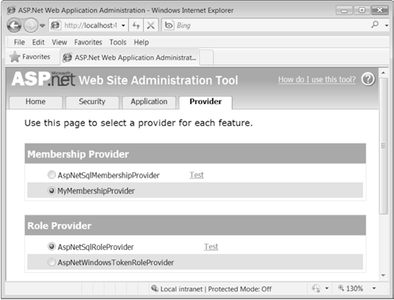
The configured provider selected in the WAT

Slide 23
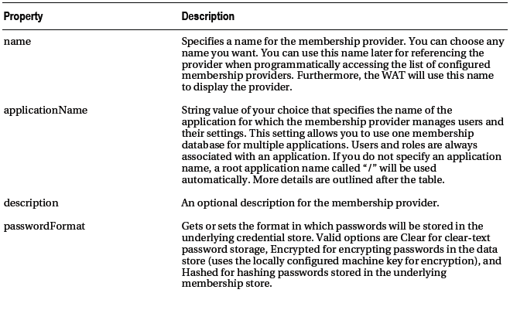
The SqlMembershipProvider’s Properties

Slide 24
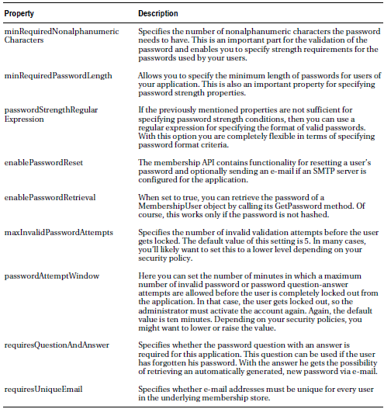
The SqlMembershipProvider’s Properties

Slide 25
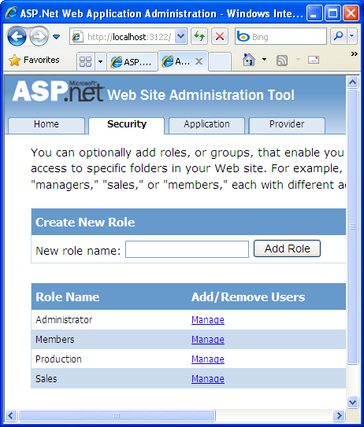
click on Enable Roles and then click on “Create or Manage Roles” link.
In the New Role Name textbox, add the necessary roles

Slide 26
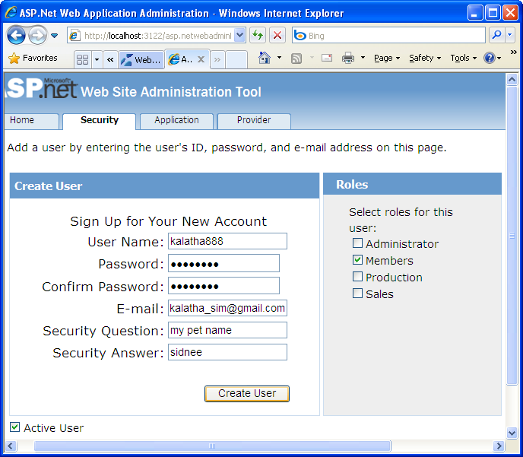
click on Create User and then enter the necessary user details

Slide 27
Authorization Settings
Recall that authorization settings are specified through the Web.config file.
<authorization>
<allow users="comma-separated list of users“ />
<deny users="comma-separated list of users“ /> </authorization>
<authorization>
<allow users=“Bob,Ed" />
<deny users=“*” />
</authorization>
<authorization>
<deny users=“?“ />
</authorization>

Slide 28
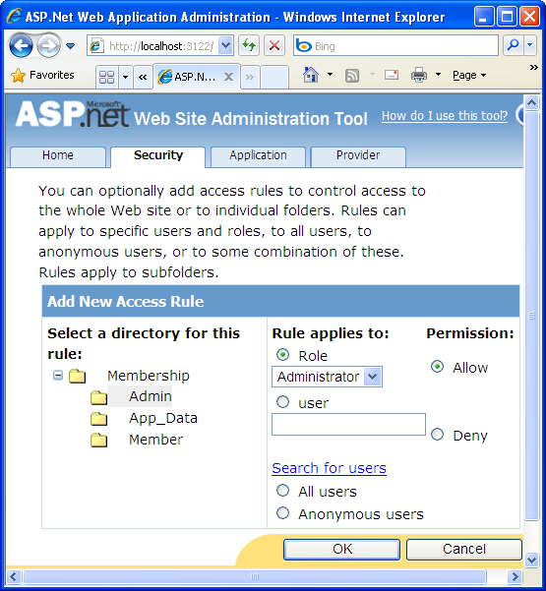
click on Create Access Rule link and then enter the necessary details to set what users are allowed to which folder

Slide 29
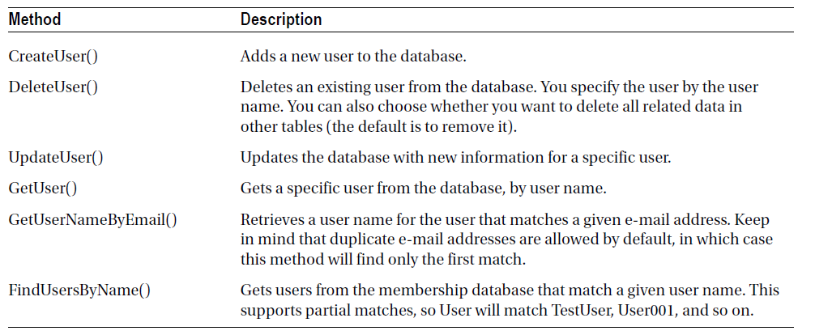
The Membership and MembershipUser Classes
Membership methods

Slide 30
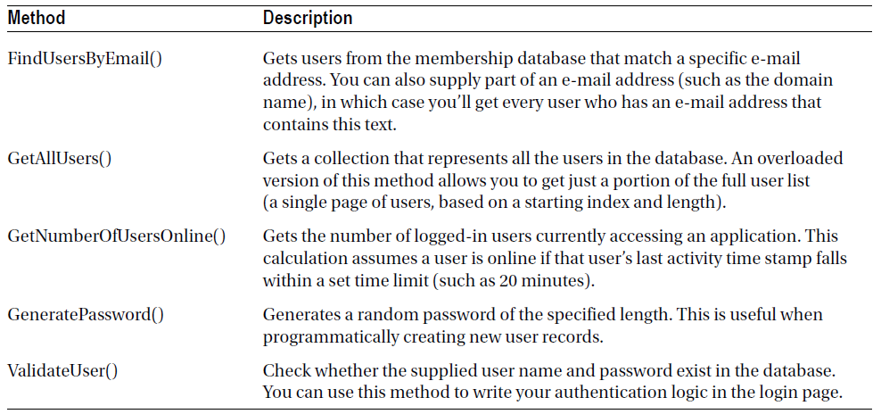
Membership methods

Slide 31
Using the Membership class to create users
' Create a user record based with user name, password, and e-mail information.
Membership.CreateUser(userName, password, email)
Here’s an example with hard-coded values:
Membership.CreateUser("joes", "ignreto12__", "joes@domains.com")

Slide 32
More complex overload of the CreateUser() method
Need to be used with the default membership settings
Dim createStatus As MembershipCreateStatus
Membership.CreateUser("joes", "ignreto12__", "joes@domains.com", _
"What is your favorite restaurant?", "Saigon", True, createStatus)
The second-to-last parameter takes a Boolean value that determines whether the account is given the IsApproved flag.
  If False, the account won’t be approved, and so it won’t be active (and usable) until it is modified using the Membership.UpdateUser() method.

Slide 33
MembershipUser class
The MembershipUser object combines the details from the aspnet_Users table and the linked aspnet_Membership table

Slide 34
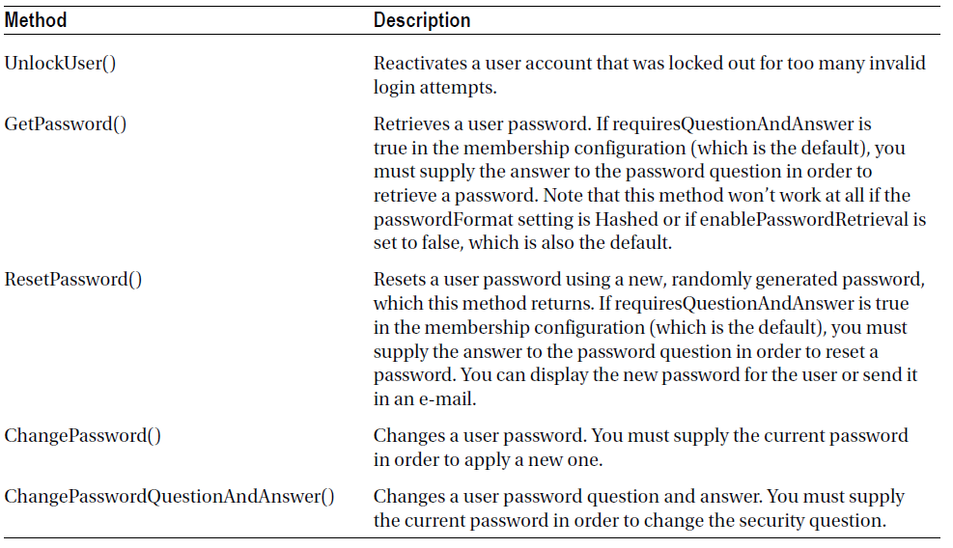
Membership User Methods

Slide 35
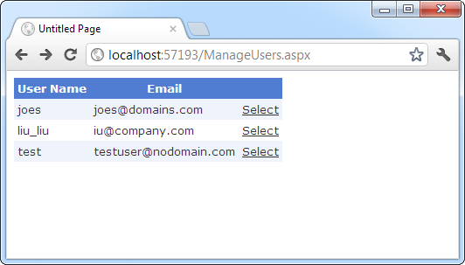
Getting a list of users

Slide 36
Defining the GridView
<asp:GridView ID = "gridUsers" runat = "server"
AutoGenerateColumns = "False" DataKeyNames = "UserName" >
<Columns>
<asp:BoundField DataField = "UserName" HeaderText = "User Name" />
<asp:BoundField DataField = "Email" HeaderText = "Email" />
<asp:CommandField ShowSelectButton = "True" />
</Columns>
</asp:GridView>

Slide 37
Calling Membership.GetAllUsers()
Protected Sub Page_Load(sender As Object, _
e As System.EventArgs) Handles Me.Load
gridUsers.DataSource = Membership.GetAllUsers()
gridUsers.DataBind()
End Sub

Slide 38
Handling SelectedIndexChanged
Protected Sub gridUsers_SelectedIndexChanged(sender As Object, _
e As System.EventArgs) Handles gridUsers.SelectedIndexChanged
Dim list As New List(Of MembershipUser)()
list.Add(Membership.GetUser(gridUsers.SelectedValue.ToString()))
detailsUser.DataSource = list
detailsUser.DataBind()
End Sub

Slide 39
The DetailsView
<asp:DetailsView ID = "detailsUser" runat = "server" > </asp:DetailsView>

Slide 40
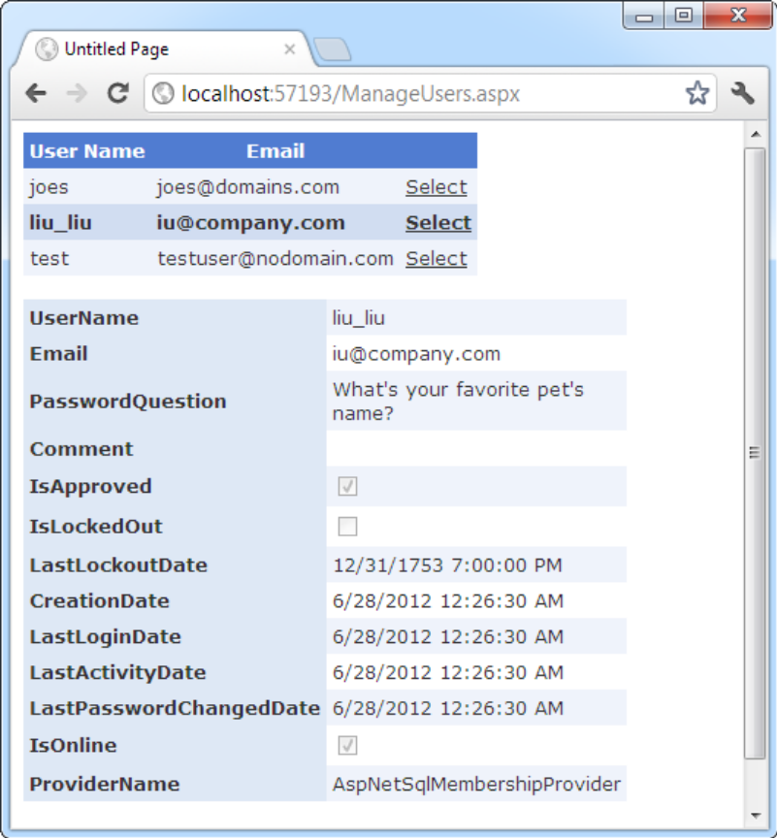
The information in a MembershipUser object

Slide 41
Authentication with Membership
Membership.ValidateUser() takes a user name and password and returns True if there’s a valid match in the database.
Protected Sub cmdLogin_Click(sender As Object, _
e As EventArgs) Handles cmdLogin.Click
If Membership.ValidateUser(txtName.Text, txtPassword.Text) Then
FormsAuthentication.RedirectFromLoginPage(txtName.Text, False)
Else
lblStatus.Text = "Invalid username or password."
End If
End Sub

Slide 42
The Security Web Controls
ASP.NET provides a number of security Web controls that interact with the Membership subsystem:
  Login – prompts the user for their credentials, and validates the user
  LoginView – has two templates – one for anonymous users, one for authenticated users.
  PasswordRecovery – allows the user to recover their password; either be told it or have it reset, depending on membership settings.

Slide 43
The Security Web Controls
  LoginStatus – displays a Login link for anonymoususers, and a Logout link for authenticated users.
  LoginName – displays the name of the currently logged on user.
  CreateUserWizard – allows a visitor to create a new user account.
  ChangePassword – provides an interface for a user to change their password.

Slide 44
The Security Web Controls
To customize the logic, program flow, or behavior of these controls, you will need to programmatically modify the events that occur at different stages in the control’s lifecycle.
  Example: For the Login control, you can add your own authentication logic by creating an event hander for the Authenticate event; you can keep an audit trail of unsuccessful logins by recording such data to a database in an event handler for the LoginError event…

Slide 45
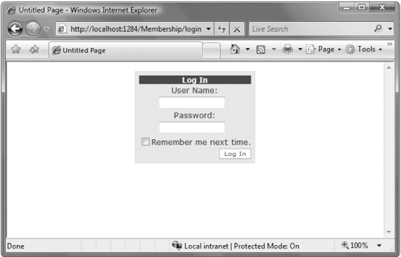
The Login Control
It encapsulates things such as Membership.ValidateUser() or FormsAuthentication.RedirectFromLoginPage()
The Login control in action

Slide 46
The Login Control
It’s completely extensible
  Can override any layout styles and properties, as well as handle events thrown by the control for overriding its default behavior

Slide 47
Changing the appearance of the Login control
<form id="form1" runat="server">
<div style="text-align: center">
<asp:Login ID="Login1" runat="server"
BackColor="aliceblue" BorderColor="Black" BorderStyle="double">
<LoginButtonStyle BackColor="darkblue" ForeColor="White" />
<TextBoxStyle BackColor="LightCyan" ForeColor="Black"
Font-Bold="true" />
<TitleTextStyle Font-Italic="true" Font-Bold="true"
Font-Names="Verdana" />
</asp:Login>
</div>
</form>

Slide 48
Changing the appearance of the Login control
Can also use CSS classes for customizing the Login control’s appearance

Slide 49
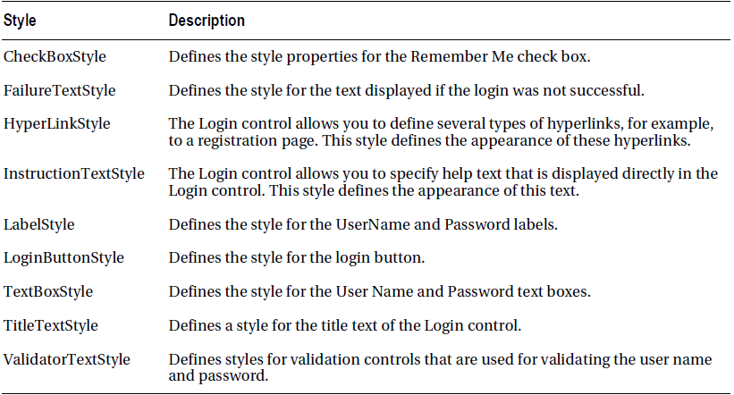
The Styles Supported by the Login Control

Slide 50
Further Customization of the Login Control
<asp:Login ID="Login1" runat="server"
BackColor="aliceblue"
BorderColor="Black" BorderStyle="double"
CreateUserText="Register"
CreateUserUrl="Register.aspx"
HelpPageText="Additional Help"
HelpPageUrl="HelpMe.htm"
InstructionText="Please enter your user name and password for <br>
logging into the system.">
<LoginButtonStyle BackColor="DarkBlue" ForeColor="White" />
<TextBoxStyle CssClass="MyLoginTextBoxStyle" />
<TitleTextStyle Font-Italic="True" Font-Bold="True" Font-Names="Verdana" />
</asp:Login>

Slide 51
Templates and the Login Control
Can use a custom template for the Login control through the LayoutTemplate tag

Slide 52
Templates and the Login Control
<asp:Login ID="LoginCtrl" runat="server"
BackColor="aliceblue"
BorderColor="Black"
BorderStyle="double">
<LayoutTemplate>
<h4>Log-In to the System</h4>
<td>
User Name:
</td>
<td>
<asp:TextBox ID="UserName" runat="server" />
<asp:RequiredFieldValidator ID="UserNameRequired"
runat="server"
ControlToValidate="UserName"
ErrorMessage="*" />
<asp:RegularExpressionValidator ID="UsernameValidator"
runat="server"
ControlToValidate="UserName"
ValidationExpression="[\w| ]*"
ErrorMessage="Invalid User Name" />
<td>
Password:
</td>
<td>
<asp:TextBox ID="Password" runat="server" TextMode="Password" />
<asp:RequiredFieldValidator ID="PasswordRequired"
runat="server"
ControlToValidate="Password"
ErrorMessage="*" />
<asp:RegularExpressionValidator ID="RegularExpressionValidator1"
runat="server"
ControlToValidate="Password"
ValidationExpression='[\w| !"§$%&amp;/()=\-?\*]*'
ErrorMessage="Invalid Password" />
<asp:CheckBox ID="RememberMe" runat="server" Text="Remember Me" />
<asp:Literal ID="FailureText" runat="server" /><br />
<asp:Button ID="Login" CommandName="Login"
runat="server" Text="Login" />
</LayoutTemplate>
</asp:Login>

Slide 53
The Login control requires at least two text boxes with the IDs UserName and Password. If those two text boxes are missing (or don’t have these ID values), the control throws an exception.

Slide 54
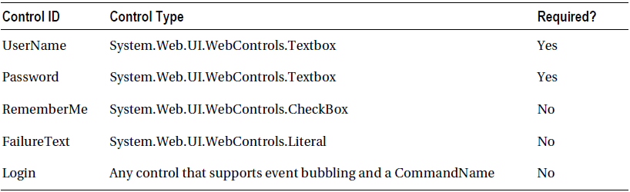
Special Controls for the Login Template

Slide 55
Only the following properties are available when using the template
  DestinationPageUrl
  VisibleWhenLoggedIn
  FailureAction
  MembershipProvider
  Password
  Username
  RememberMeSet

Slide 56
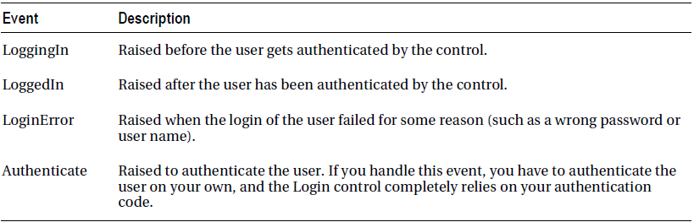
Programming the Login Control
The Events of the Login Control

Slide 57
LoginError event
Use the LoginError event to automatically redirect the user to the password recovery page after a specific number of attempts

Slide 58
LoginError event
Protected Sub Page_Load(ByVal sender As Object, ByVal e As System.EventArgs) Handles Me.Load
If Not Me.IsPostBack Then
ViewState("LoginErrors") = 0
End If
End Sub
Protected Sub LoginCtrl_LoginError(ByVal sender As Object, ByVal e As System.EventArgs) Handles LoginCtrl.LoginError
'If the "LoginErrors" state does not exist, create it
If ViewState("LoginErrors") Is Nothing Then
ViewState("LoginErrors") = 0
End If
' Increase the number of invalid logins
Dim ErrorCount As Integer =
CInt(ViewState("LoginErrors")) + 1
ViewState("LoginErrors") = ErrorCount
‘ Now validate the number of errors
If (ErrorCount > 3) AndAlso (LoginCtrl.PasswordRecoveryUrl <> String.Empty) Then
Response.Redirect(LoginCtrl.PasswordRecoveryUrl)
End If
End Sub

Slide 59
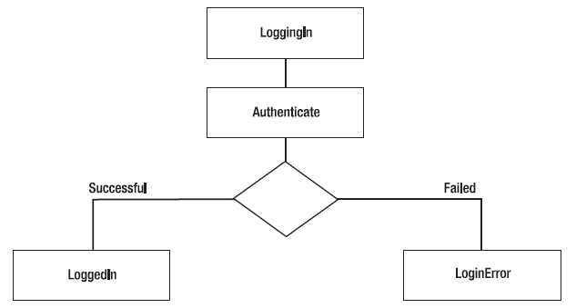
The Login control fires the events in the following order

Slide 60
The Authenticate event
Receives an instance of AuthenticateEventArgs as a parameter
  has a property called Authenticated
  If set to true, the Login control assumes that authentication was successful and raises the LoggedIn event.
    the user is redirected to the Login.DestinationPageUrl (or the original page the user came from if the DestinationPageUrl property is not set)
  If set to false, it displays the FailureText and raises the LoginError event
    the control displays the error message defined by the Login.FailureText property

Slide 61
Example
Protected Sub LoginCtrl_Authenticate (
ByVal sender As Object, ByVal e As System.Web.UI.WebControls.AuthenticateEventArgs
) Handles LoginCtrl.Authenticate
If YourValidationFunction(LoginCtrl.UserName, LoginCtrl.Password) Then
e.Authenticated = True
Else
e.Authenticated = False
End If
End Sub

Slide 62
can use the Login control’s FindControl method to get the control in addition to the controls with the IDs UserName and Password

Slide 63
Example
<asp:Login ID="OtherLoginCtrl" runat="server"
BackColor="aliceblue"
BorderColor="Black"
BorderStyle="double"
PasswordRecoveryUrl="./pwdrecover.aspx"
OnAuthenticate="OtherLoginCtrl_Authenticate">
<LayoutTemplate>
<div style="font-family: Courier New">
Userskey: <asp:Textbox ID="AccessKey" runat="server" /><br />
User Name: <asp:TextBox ID="UserName" runat="server" /><br />
Password: <asp:TextBox ID="Password" runat="server"
TextMode="password" Width="149px" /><br />
<asp:Button runat="server" ID="Login” CommandName="Login" Text="Login" />
</div>
</LayoutTemplate>
</asp:Login>

Slide 64
Protected Sub OtherLoginCtrl_Authenticate(ByVal sender As Object, ByVal e As System.Web.UI.WebControls.AuthenticateEventArgs
) Handles OtherLoginCtrl.Authenticate
Dim AccessKeyText As TextBox = DirectCast(
OtherLoginCtrl.FindControl("AccessKey"), TextBox)
If YourValidation(AccessKeyText.Text, OtherLoginCtrl.UserName) Then
e.Authenticated = True
Else
e.Authenticated = False
End If
End Sub

Slide 65
The LoginStatus Control
Displays either a login link if the user is not authenticated or a logout link if the user is authenticated
The login link automatically redirects to the configured login page
The logout link automatically calls the method FormsAuthentication.SignOut for logging off the user

Slide 66
The LoginStatus Control
<asp:LoginStatus ID="LoginStatus1" runat="server"
LoginText="Sign In"
LogoutText="Sign Out"
LogoutPageUrl="./Default.aspx"
LogoutAction="Redirect" />

Slide 67
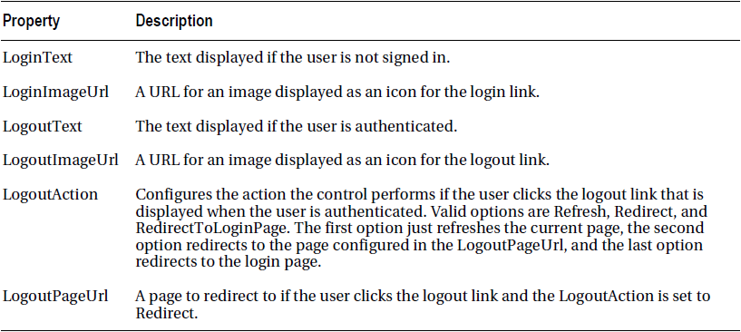
Properties for Customizing the LoginStatus Control

Slide 68
The LoginView Control
To display a different set of controls for anonymous and authenticated users
To display different content based on which roles the currently logged-in user is assigned to

Slide 69
The LoginView Control
<asp:LoginView ID="LoginViewCtrl" runat="server">
<AnonymousTemplate>
<h2>You are anonymous</h2>
</AnonymousTemplate>
<LoggedInTemplate>
<h2>You are logged in</h2>
Submit your comment: <asp:TextBox runat="server" ID="CommentText" />
<br />
<asp:Button runat="server" ID="SubmitCommentAction" Text="Submit" />
</LoggedInTemplate>
</asp:LoginView>

Slide 70
Supports two events
ViewChanging
  is raised before the control displays content defined in another template
ViewChanged
  is raised after the control has changed the content display from one template to another

Slide 71
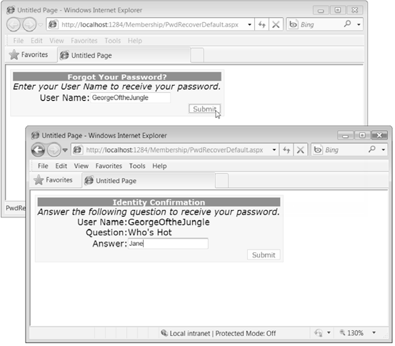
The PasswordRecovery Control
The PasswordRecovery control in action

Slide 72
The PasswordRecovery Control
If the membership provider stores the password in a hashed form, it automatically generates a new, random password and sends the new password in the e-mail

Slide 73
The PasswordRecovery Control
<asp:PasswordRecovery ID="PasswordRecoveryCtrl" runat="server"
BackColor="Azure"
BorderColor="Black" BorderStyle="solid">
<MailDefinition From="proaspnet2@apress.com"
Subject="Forgotten Password"
Priority="high" />
<TitleTextStyle Font-Bold="true" Font-Italic="true" BorderStyle="dotted" />
<TextBoxStyle BackColor="Yellow" BorderStyle="double" />
<FailureTextStyle Font-Bold="true" ForeColor="Red" />
</asp:PasswordRecovery>

Slide 74
Configure the SMTP mail server in your web.config file
<system.net>
<mailSettings>
<smtp deliveryMethod="Network“ from=“mailmaster@webtech.com">
<network
host="localhost"
port="25"
defaultCredentials="true" />
</smtp>
</mailSettings>
</system.net>

Slide 75
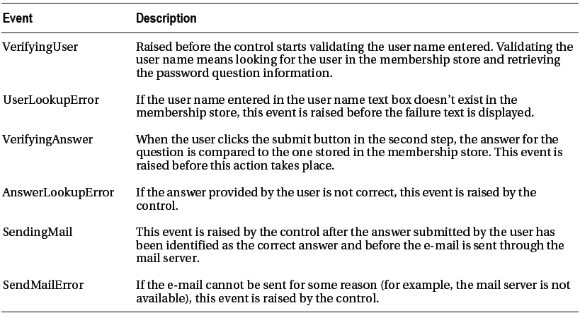
Events of the PasswordRecovery Control

Slide 76
Needs to go through three steps:-
  requests the user name
  shows the security question and requests the answer
  sends an e-mail to the user’s e-mail address

Slide 77
PasswordRecovery Templates
The control supports templates for every view
  UserNameTemplate
  QuestionTemplate
  SuccessTemplate
Every template has certain required controls

Slide 78
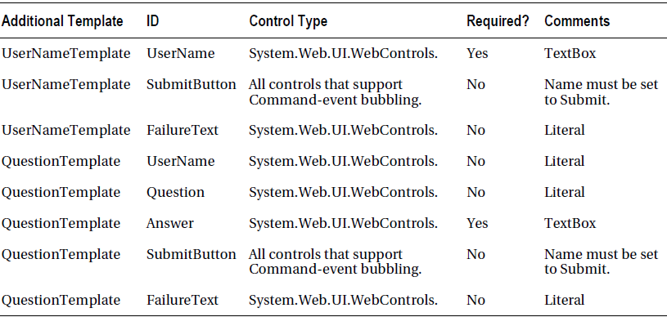
Special Controls for PasswordRecovery Templates

Slide 79
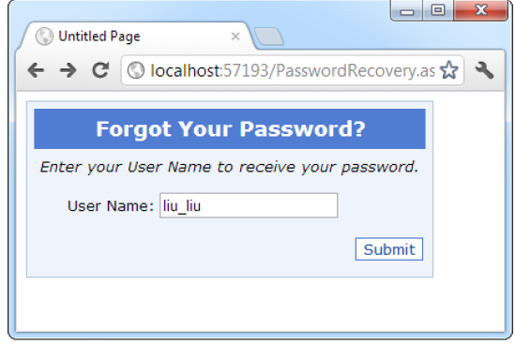
Requesting the user name

Slide 80
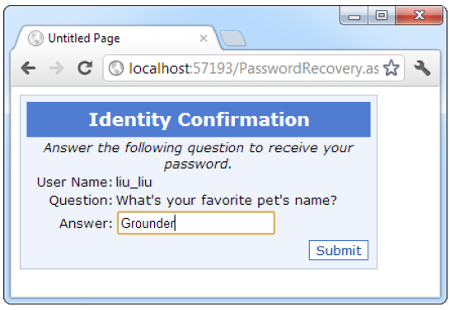
Security question and answer

Slide 81
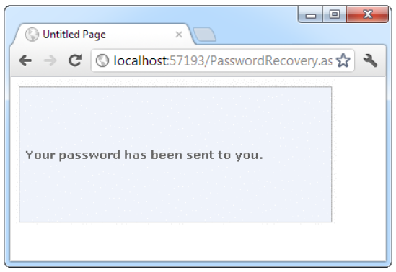
Sending an e-mail

Slide 82
Handling the PasswordRecovery.SendingMail event
Protected Sub PasswordRecovery1_SendingMail(sender As Object, _
e As System.Web.UI.WebControls.MailMessageEventArgs) _
Handles PasswordRecovery1.SendingMail
e.Cancel = True
PasswordRecovery1.SuccessText = e.Message.Body
End Sub
To display the new password directly on the page, set the MailMessageEventArgs.Cancel property to True

Slide 83
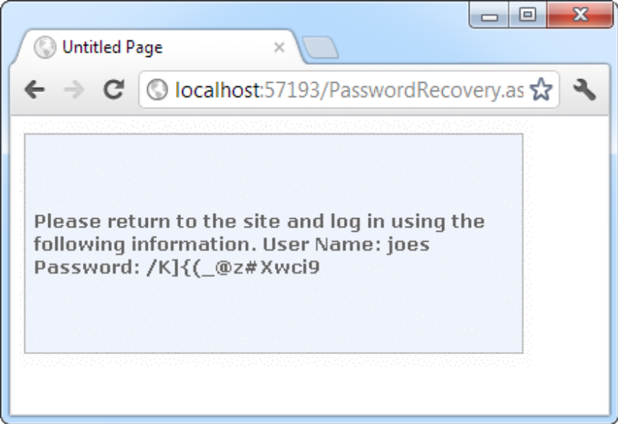
Displaying the retrieved or regenerated password

Slide 84
Using the FindControl method
Use the FindControl method for finding the control (which is actually a child control of the PasswordRecovery template control) in the appropriate template
Protected Sub PasswordTemplateCtrl_SendingMail( ByVal sender As Object,
ByVal e As System.Web.UI.WebControls.MailMessageEventArgs
) Handles PasswordTemplateCtrl.SendingMail
Dim lbl As Label =
DirectCast(
PasswordTemplateCtrl.SuccessTemplateContainer.FindControl("EmailLabel"),Label)
lbl.Text = e.Message.To(0).Address
End Sub

Slide 85
The ChangePassword Control
The control simply queries the user name as well as the old password from the user. Then it requires the user to enter the new password and confirm the new password.
<asp:ChangePassword ID="ChangePwdCtrl" runat="server"
BorderStyle="groove" BackColor="aliceblue">
<MailDefinition From="pwd@apress.com"
Subject="Changes in your profile"
Priority="high" />
<TitleTextStyle Font-Bold="true" Font-Underline="true"
Font-Names="Verdana" ForeColor="blue" />
</asp:ChangePassword>

Slide 86
Two templates are required when customizing the control
  ChangePasswordTemplate
  SuccessTemplate
ChangePasswordTemplate requires you to add some special controls with special IDs and CommandName property values

Slide 87
<asp:ChangePassword ID="ChangePwdCtrl" runat="server">
<ChangePasswordTemplate>
Old Password:&nbsp;
<asp:TextBox ID="CurrentPassword" runat="server"
TextMode="Password" /><br />
New Password:&nbsp;
<asp:TextBox ID="NewPassword" runat="server"
TextMode="Password" /><br />
Confirmation:&nbsp;
<asp:TextBox ID="ConfirmNewPassword" runat="server"
TextMode="Password" /><br />
<asp:Button ID="ChangePasswordPushButton" CommandName="ChangePassword"
runat="server" Text="Change Password" />
<asp:Button ID="CancelPushButton" CommandName="Cancel"
runat="server" Text="Cancel" /><br />
<asp:Literal ID="FailureText" runat="server"
EnableViewState="False" />
</ChangePasswordTemplate>

Slide 88
The CreateUserWizard Control
CreateUserWizard inherits from the base Wizard control
Three types of properties:-
  Style properties that format just a section of the control: For example, TitleTextStyle configures how the text heading is formatted.
  Properties that set the text for the control: For example, you can configure each label, the success text, and the messages shown under different error conditions. You can also retrieve or set the values in each text box.
  Properties that hide or show a part of the control: For example, you can use DisplaySideBar, DisplayCancelButton, and RequireEmail to show or hide the sidebar, cancel button, and e-mail text box, respectively.

Slide 89
CreateUserWizard control events
CreatingUser
CreatedUser,
CreateUserError

Slide 90
can add as many extra steps as you want
actual user-creation process must always take place in a single step
supports two specialized step types:-
  CreateUserWizardStep
  CompleteWizardStep

Slide 91
<asp:CreateUserWizard ID="RegisterUser" runat="server"
BorderStyle="ridge" BackColor="aquamarine">
<TitleTextStyle Font-Bold="true" Font-Names="Verdana" />
<WizardSteps>
<asp:CreateUserWizardStep runat="server">
</asp:CreateUserWizardStep>
<asp:CompleteWizardStep runat="server">
</asp:CompleteWizardStep>
</WizardSteps>
</asp:CreateUserWizard>

Slide 92
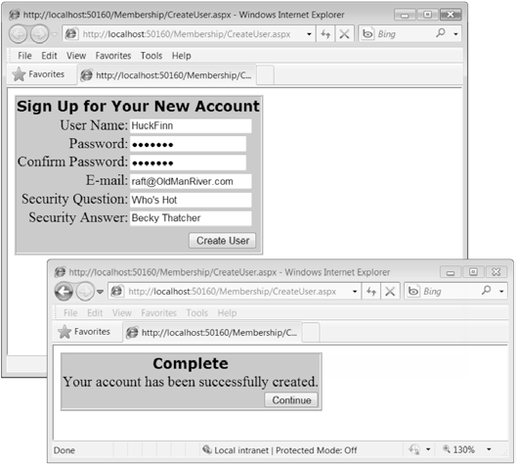
A simple CreateUserWizard control

Slide 93
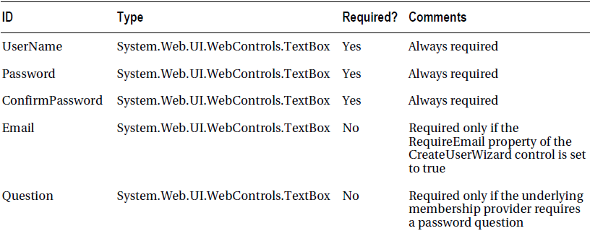
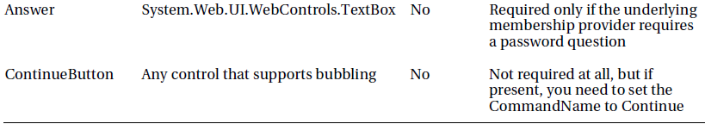
Required Controls and Optional Controls

Slide 94
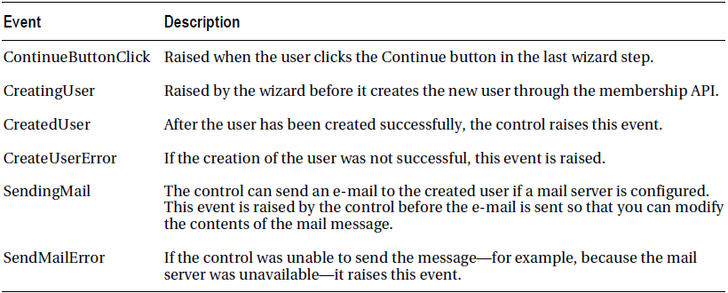
The CreateUserWizard Events

Slide 95
A Working Example
  Create a Login Page
  Use the LoginView Control
  Allow a User Account to be Created Through the CreateUserWizard Control

Slide 96
Create a Login Page
By default, the Login page must be named login.aspx and appear in the root directory of your website.
  If you use a different path/file name, you need to specify it in via the loginUrl attribute of the <forms> element within the <authentication> element in Web.config:
  <authentication mode="Forms">
  <forms loginUrl="loginPageUrl" ... />
  </authentication>

Slide 97
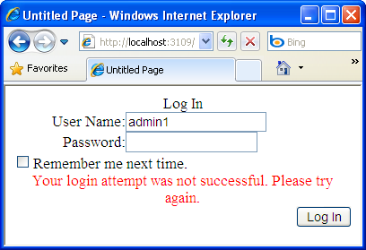
Create a Login Page
Simplest approach – just add a Login Web control to the page!
  Uses the Membership API’s ValidateUser method to determine if the user’s credentials are valid.
  Includes validation controls to ensure that the user provides a username & password

Slide 98
Can customize authentication logic by creating an event handler for the Authenticate event.
  Ex: user authentication is done by entering the username, password, and email
    Convert Login control to a template, add a TextBox to collect Email address
    In Authenticate event handler, use the Membership API to verify the user, then check to ensure the email entered matches the one on file.
      In the Authenticate event handler, must set the e.Authenticated property to True or False, indicating whether authentication has succeeded of failed

Slide 99
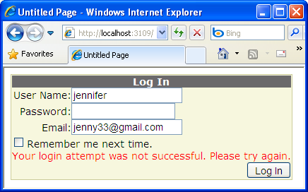
Protected Sub Authenticate(ByVal sender As Object, ByVal e As AuthenticateEventArgs)
Dim user As String = Login1.UserName
Dim passwd As String = Login1.Password
Dim email As TextBox = Login1.FindControl("Email")
If Membership.ValidateUser(user, passwd) Then
Dim userInfo As MembershipUser = Membership.GetUser(User)
If (String.Compare(userInfo.Email, email.Text.ToString, True) = 0) Then
e.Authenticated = True
Else
e.Authenticated = False
End If
Else
e.Authenticated = False
End If
End Sub

Slide 100
Use the LoginView Control
The LoginView control can be used to display different content to logged in users vs. anonymous users.
  Ex: Show a Login box to an anonymous user, while a logged in user sees a message like, “You are logged in as, username!”
  Can also base the content display based on Roles.

Slide 101
<asp:LoginView ID="LoginView1" runat="server">
<AnonymousTemplate>Hello, please proceed to
<a href="login.aspx">User Login</a>
</AnonymousTemplate>
<RoleGroups>
<asp:RoleGroup Roles = "Administrator">
<ContentTemplate >
Hello Administrator, <asp:LoginName id="LoginName" runat="server" />
</ContentTemplate>
</asp:RoleGroup>
<asp:RoleGroup Roles="Member">
<ContentTemplate>
Hello Member, <asp:LoginName ID="LoginName1" runat="server" />
</ContentTemplate>
</asp:RoleGroup>
</RoleGroups>
<LoggedInTemplate>
You are logged in as: <asp:LoginName ID="LoginName1" runat="server" />
<br />
Login Status: <asp:LoginStatus ID="LoginStatus1" runat="server" />
</LoggedInTemplate>
</asp:LoginView>

Slide 102
Creating User Accounts
The CreateUserWizard provides a packaged control for a user creating a new account.
  Internally, CreateUserWizard uses the Membership class’s CreateUser method to create a new user account after the user has entered valid inputs
  CreateUserWizard includes the questions and password strength requirements as specified by the Membership provider. For the SqlMembershipProvider, recall that those are spelled out in Web.config.

Slide 103
Creating User Accounts
Properties, at minimum:
  ContinueDestinationPageUrl property, which indicates what page the user should be sent to after creating an account.
  LoginCreatedUser property to indicate if the person who just created the new account should be logged on to that new account (defaults to True)

Slide 104
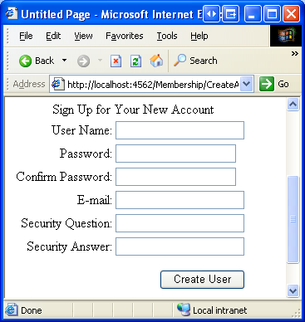
CreateUserWizard

Slide 105
Role-Based Security
To enable it,
<configuration>
. . .
<system.web>
. . .
<roleManager enabled = "true" />
</system.web>
</configuration>

Slide 106
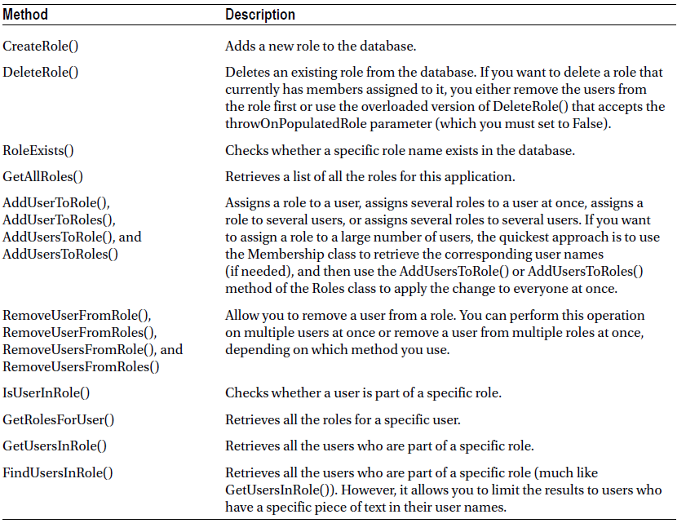
Creating and Assigning Roles
Methods of the Roles Class

Slide 107
Assign a newly created user into a specific role
Protected Sub CreateUserWizard1_CreatedUser(sender As Object, _
e As System.EventArgs) Handles CreateUserWizard1.CreatedUser
Roles.AddUserToRole(CreateUserWizard1.UserName, "User")
End Sub

Slide 108
Restricting Access Based on Roles
write authorization rules in web.config file
<authorization>
<deny users = "?" />
<deny roles = "Guest" />
<allow users = "*" />
</authorization>

Slide 109
Using the User.IsInRole() method
Protected Sub Page_Load(sender As Object, _
e As System.EventArgs) Handles Me.Load
lblMessage.Text = "You have reached the secured page, "
lblMessage.Text & = User.Identity.Name & "."
If User.IsInRole("Administrator") Then
lblMessage.Text & = " < br /> < br />Congratulations:"
lblMessage.Text & = "you are an administrator."
End If
End Sub

Slide 110
Using the LoginView control
<asp:Login View ID = "LoginView1" runat = "server">
<AnonymousTemplate>
<h1 > You are anonymous</h1>
Why don't you < a href = "Login.aspx" > log in</a > ?
</AnonymousTemplate>
<RoleGroups>
<asp:RoleGroup Roles = "User, Guest">
<ContentTemplate>
<p > If you can see this, you are a member of the
User or Guest roles.</p>
</ContentTemplate>
</asp:RoleGroup>

Slide 111
<asp:RoleGroup Roles = "Administrator">
<ContentTemplate>
<p > Congratulations, you are an administrator.</p>
</ContentTemplate>
</asp:RoleGroup>
</RoleGroups>
</asp:LoginView>
When matching the role to a RoleGroup, the LoginView control goes through the RoleGroup tags in order and uses the first match. If it can’t find a match, it uses the ordinary <LoggedInTemplate > .

